Slide 1

University of Central Florida COP 3330 Object Oriented Programming

Slide 2
Agenda
Administrative
Javadoc

Slide 3
Javadoc

Slide 4
Javadoc
Project documentation
You’ll probably get stuck with it!
As a developer, always comment your code!
Javadoc makes it easy to accomplish this!
Netbeans and other IDEs make it easy to accomplish this!
You have no excuses not to comment!
Javadoc is a tool that generates HTML documentation from Javadoc comments in the code
write basic Javadoc comments
how to use features of Javadoc to generate HTML documentation

Slide 5
Javadoc Comments
Javadoc recognizes special comments /** .... */ which are highlighted in a default color based on the IDE
Javadoc allows you to attach descriptions to any part of the source code which translates to the generated HTML documentation by placing Javadoc comments directly before their declaration statements
Classes
Constructors
Fields
Interfaces
Methods

Slide 6
Javadoc Comments
Here's an example using Javadoc comments to describe a class, a field and a constructor:
/** Class Description of MyClass */
public class MyClass {
/** Field Description of myIntField */
public int myIntField;
/** Constructor Description of MyClass() */ public MyClass()
{ // Do something ... }
}

Slide 7
Javadoc Tags
Tags are keywords recognized by Javadoc which define the type of information that follows
Tags come after the description (separated by a new line)
Here are some common pre-defined tags:
@author [author name] - identifies author(s) of a class or interface
@version [version] - version info of a class or interface
@param [argument name] [argument description] - describes an argument of method or constructor
@return [description of return] - describes data returned by method (unnecessary for constructors and void methods)
@exception [exception thrown] [exception description] - describes exception thrown by method
@throws [exception thrown] [exception description] - same as @exception

Slide 8
Javadoc Tags
/** Description of MyClass
* @author John Doe
* @author Jane Doe
* @version 6.0z Build 9000 Jan 3, 1970.
*/
public class MyClass {
/** Description of myIntField */
public int myIntField;
/** Description of MyClass()
* * @throws MyException Description of myException
*/
public MyClass() throws myException
{ // Blah Blah Blah... }
/** Description of myMethod(int a, String b)
*
* @param a Description of a
* @param b Description of b
* @return Description of c
*/
public Object myMethod(int a, String b)
{ Object c; // Blah Blah Blah... return c; } }

Slide 9
Javadoc and Netbeans
Every IDE handles Javadoc uniquely, for Netbeans here are some tips
Analyze the source code for appropriate Javadoc
Repair any missing Javadoc
Generate the Javadoc documentation
Review documentation
Note that the following guidance is based on Netbeans IDE 8.0.2; changes may be applicable for different versions

Slide 10
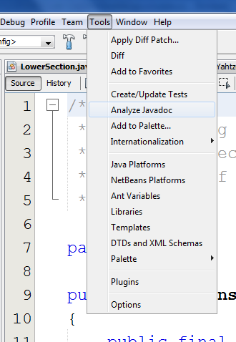
Analyze Javadoc
To analyze the completeness of a project’s Javadoc use the Analyze tool
Tools→Analyze Javadoc

Slide 11
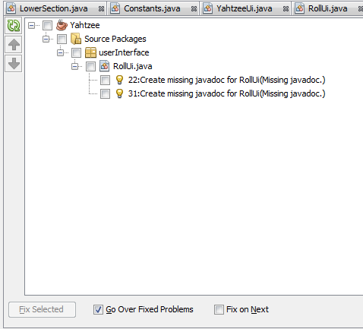
Repair Javadoc
Use the Analyzer result screen to have Netbeans automatically fix missing Javadoc
Be sure to verify what was generated, it may not be complete

Slide 12
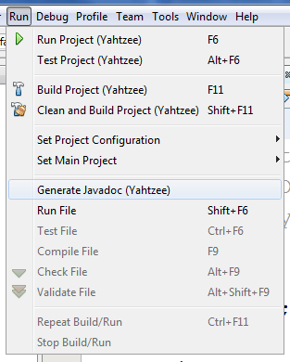
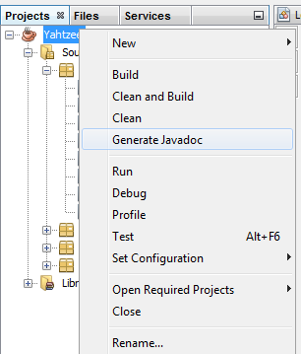
Generate Javadoc
Generate Javadoc using one of two options
Run→Generate Javadoc
Select Project in Projects view, right click, select Generate Javadoc

Slide 13
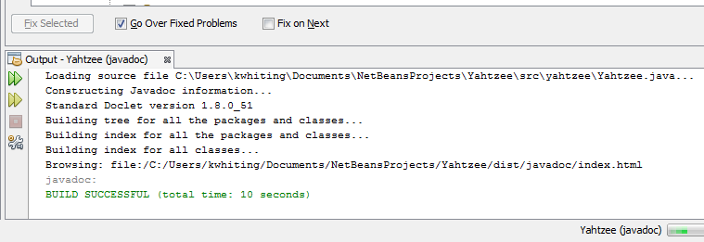
Generate Javadoc
When the Javadoc is being generated…

Slide 14
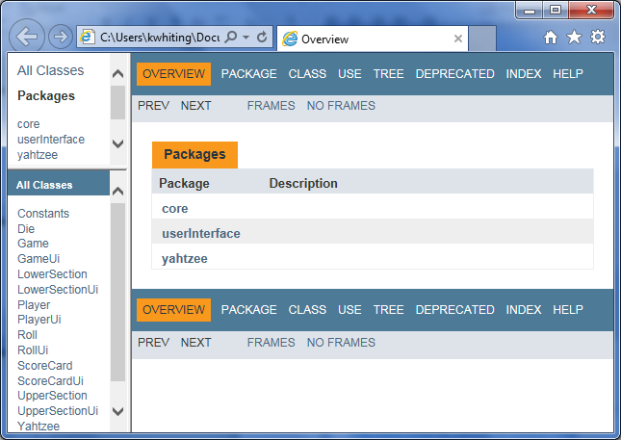
Review Javadoc
Netbeans should automatically launch the generated HTML Javadoc

Slide 15
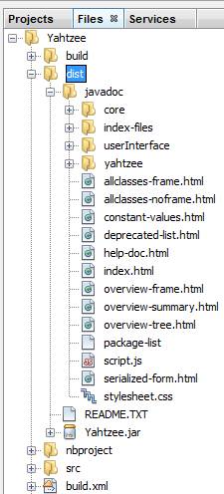
Review Javadoc
If Netbeans does not automatically launch the generated HTML Javadoc then browse to the identified folder where the Javadoc was stored in
Hint: look at the output window
file:/C:/Users/kwhiting/Documents/NetBeansProjects/Yahtzee/dist/javadoc/index.html
Use the Files window, you won’t see it in the Projects window

